Slide 1
A Neural Network for Relational Reasoning and Prediction
Siyu Jiang

Slide 2
What are you trying to do?
Basically a relational Reasoning neural network
Take in images
Answer questions
How does it different from other image based neural network?

Slide 3
Difference
Traditional neural network usually performs classification:
Simply detect the major object in an image
Should always produce same answer with same image input
Relational reasoning neural network performs relational answering:
Usually trained on images contains multiple equally important objects
Input contains images and questions
Different answer on different questions

Slide 4
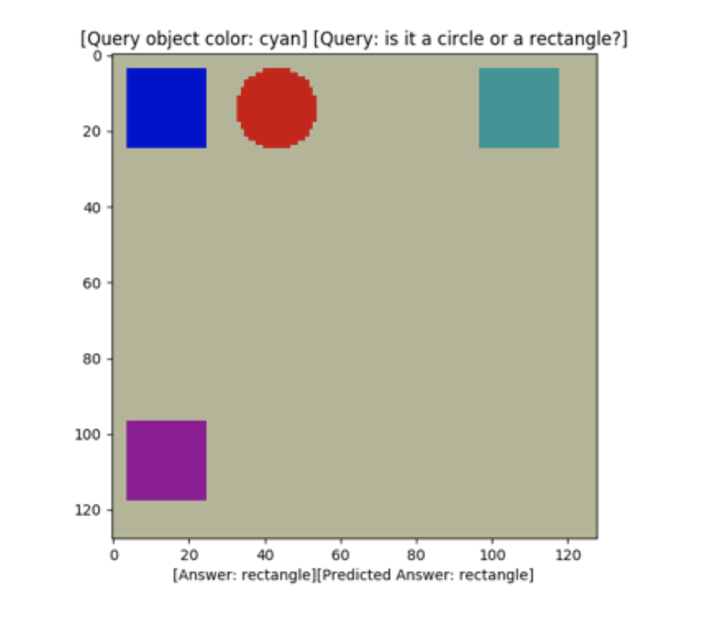
For example
Consider this input:

Slide 5
Normal NN classifier:
Simple output: circle, square
May be undetermined because of multiple objects
Relational reasoning NN:
Taking in questions: “The color of the nearest object to the blue object?”
Output: red
OR “The shape of the nearest object to the blue object?”
Output: circle

Slide 6
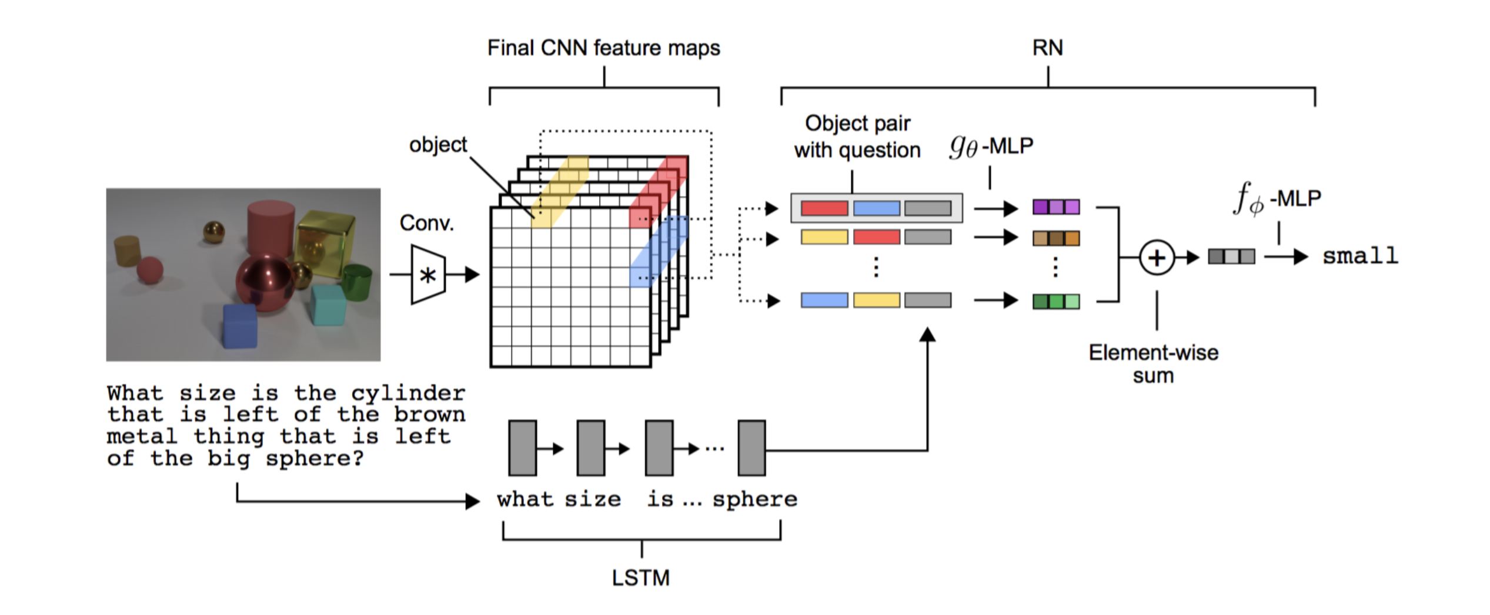
How does it work?
Current approach: CNN+MLP

Slide 7
CNN
trained on images
Feature extraction
Feed information into relation network

Slide 8
Relation network
A multilayer perceptron
Taking questions and image features pass from CNN
Trained together with CNN as a whole
End-to-end

Slide 9
My task
Input: image diagrams drawn with human logics
Output: relational answering and prediction

Slide 10
Data: force diagram
Question to ask:
“is the object experiencing an up force?”
“what will be the direction of movement?”

Slide 11
My approach
Model:
Based on an open source implementation of the model in A simple neural network module for relational reasoning
This build is not implement by authors themselves, so it does not support all types of question in paper
Should be enough for a 2D static diagram
Data set:
Using python to automated generate force diagram with question and answer label
Can be challenging to verify if the size grows large

Slide 12
Future work
Adding program synthesis techniques to generate code from diagram
Some related but not necessarily similar work: Learning to Infer Graphics Programs from Hand-Drawn Images https://arxiv.org/pdf/1707.09627.pdf
for example:
Generate a BST class based on a diagram representation of it
Perform array operation based on instructions in diagram
…

Slide 13
Milestones
Midterm I (11/05): Rebuild and modify the public implementation of previous model
Midterm II(11/19): Model should be able to answer relational questions
Final (12/10): Model should be able to make perdiction

